Slide 1
PROJECT TITLE: PLACEMENT HUB
DESCRIPTION: A web application for students to register, upload resumes, explore job opportunities, and get placement notifications.
Team Leader Name :
K. Nandhini(23R91A05F7)
GitHub link: https://github.com/Nandhini989
Team members :
1.K. Poojitha(23R91A05G6)
2.K. Sruthi(24R91A0516)
3.P. Mani Priya(23R91A05R0)

Slide 2
PROBLEM STATEMENT
Students and placement cells face challenges in managing recruitment information, eligibility, and communication. A centralized Placement Hub is needed to streamline placement activities, provide real-time updates, and connect students, recruiters, and administrators efficiently.

Slide 3
CASE STUDY
Problem:
Manual placement processes cause delays, miscommunication, and poor tracking of resumes & job postings.
Proposed Solution:
Placement Hub – a web-based platform where:
Students register, upload resumes, and get job notifications.
Admins/recruiters post jobs and manage applications.
Technology Used:
Python (Django), HTML, CSS, JavaScript, SQLite/PostgreSQL.
Impact:
Centralized placement management.
Faster communication.
Easy job tracking and resume handling.

Slide 4

LANDING PAGE

Slide 5
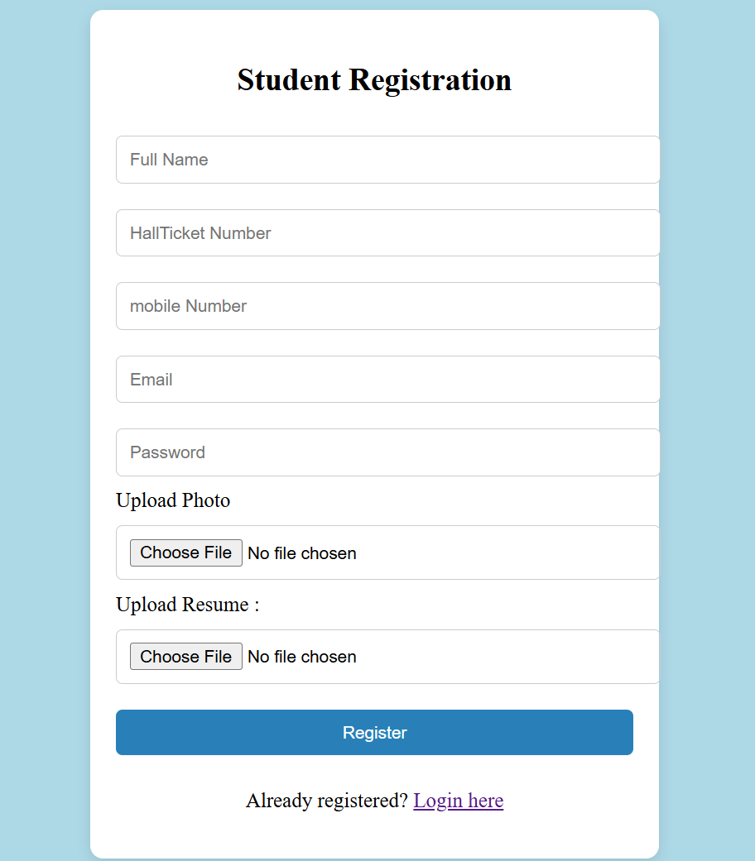
REGISTRATION PAGE

Slide 6
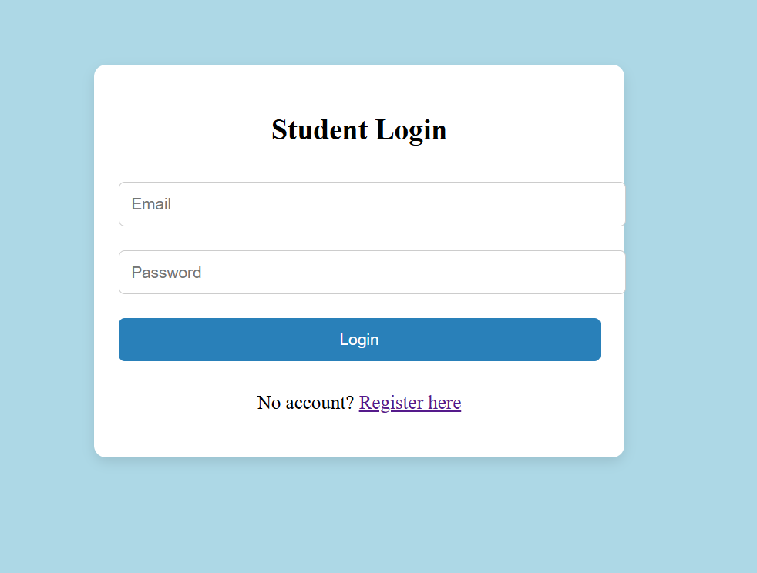
LOGIN PAGE

Slide 7
REFERENCES
Internshala – Internships & Training, https://internshala.com/
LinkedIn – Professional Networking & Job Portal, https://www.linkedin.com/
AI Tools

Slide 8
THANK YOU

